Slide 1
BIOS27815: Infectious Diseases
NGS Outbreak Investigation
UChicago Center in Paris
Paris, France
January 2025

Slide 2
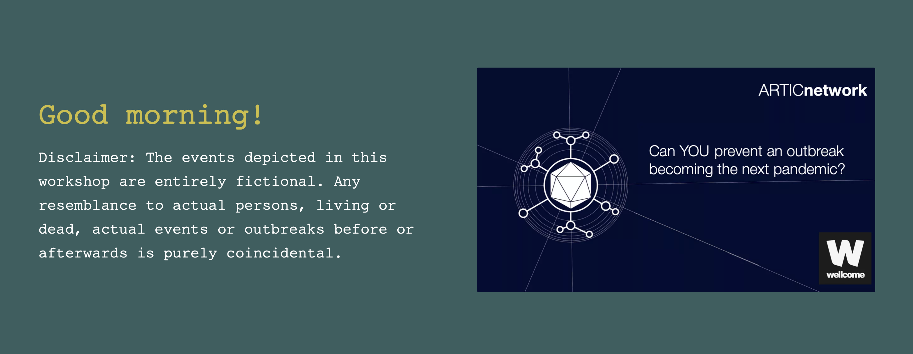

Slide 3
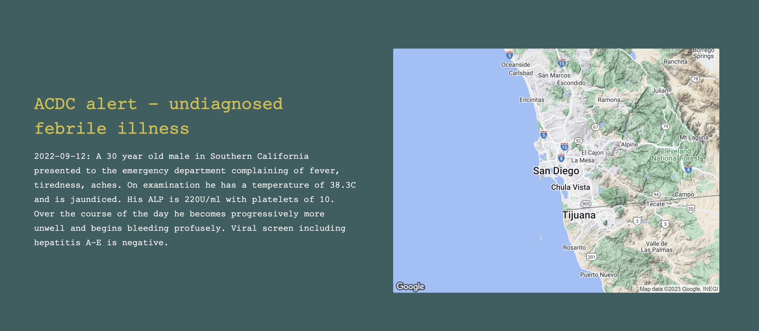

Slide 4
What is your diagnosis?

Slide 5
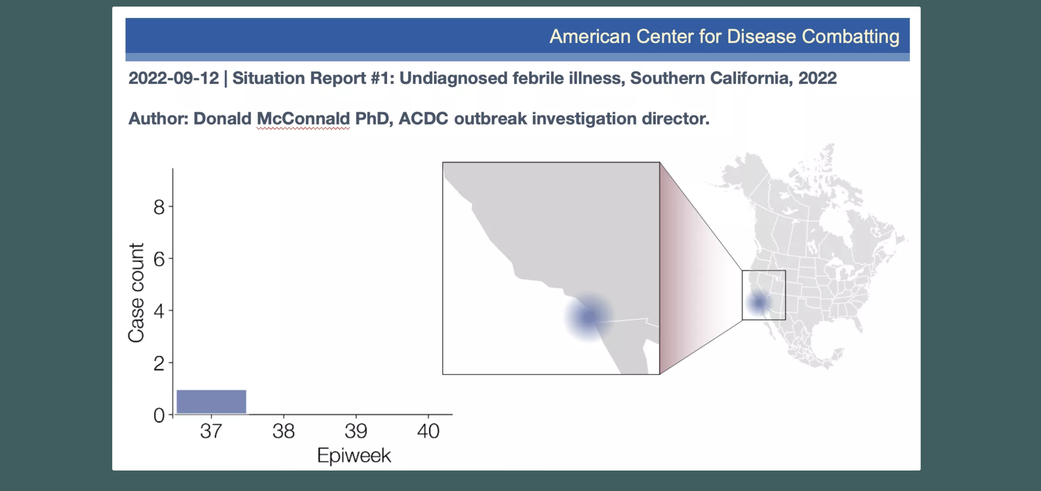

Slide 6
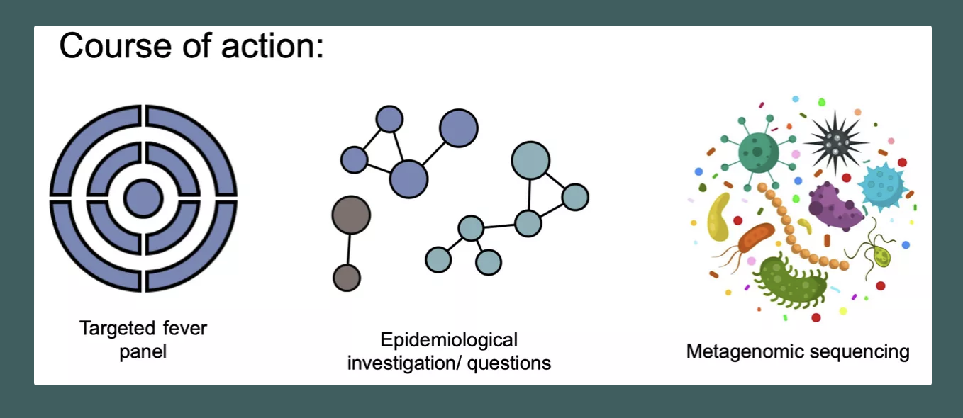
What should we try?

Slide 7
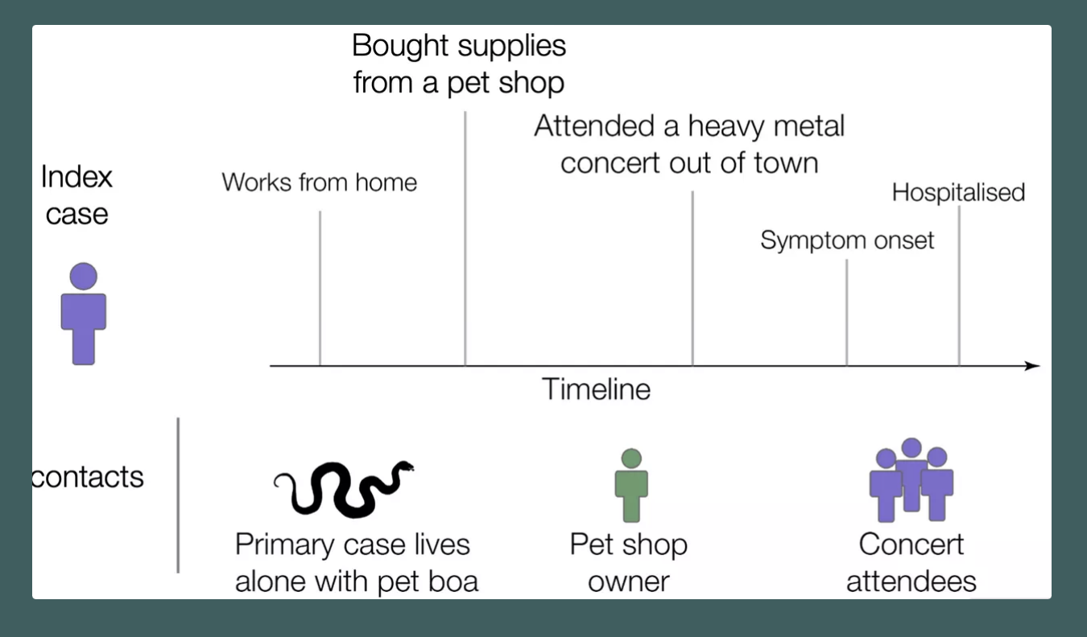
Enhanced epidemiology investigation

Slide 8
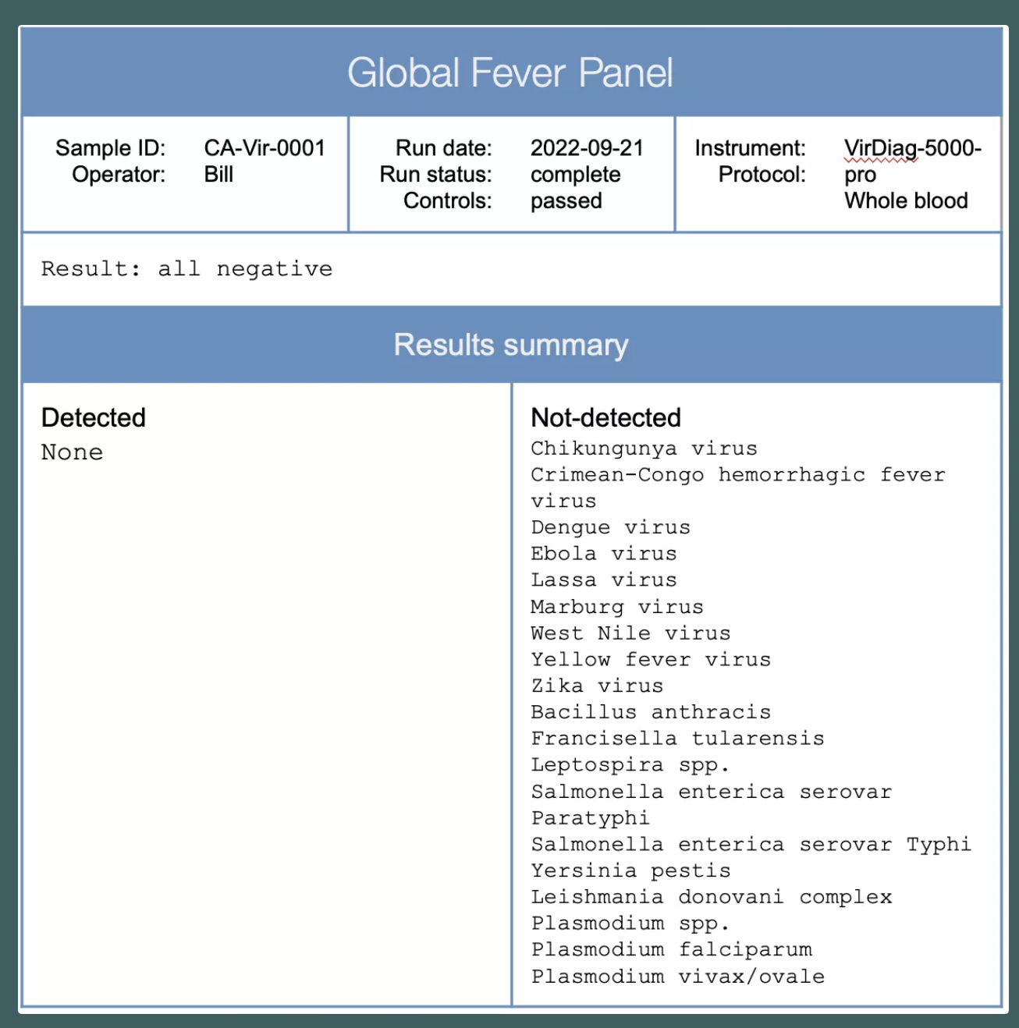
Global fever panel

Slide 9
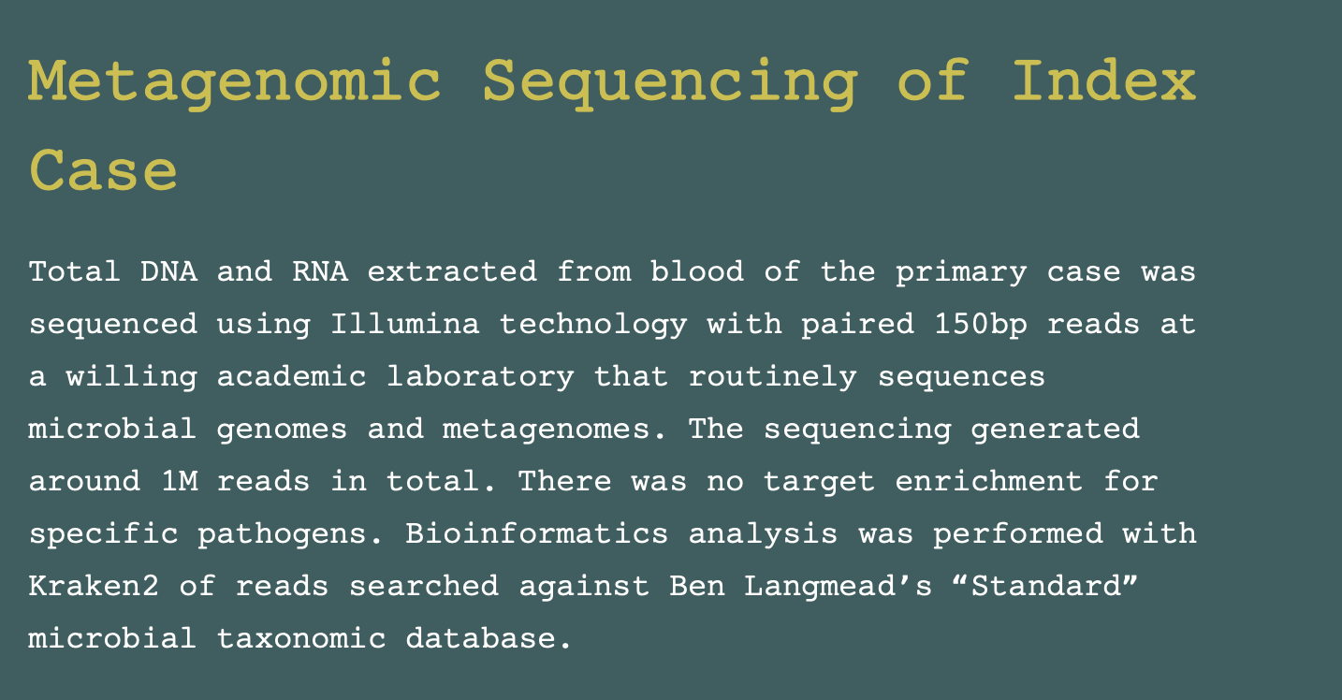
https://artic-network.github.io/artic-live/gc/index_case_title.html

Slide 10
What plausible pathogenic agents did you find?

Slide 11
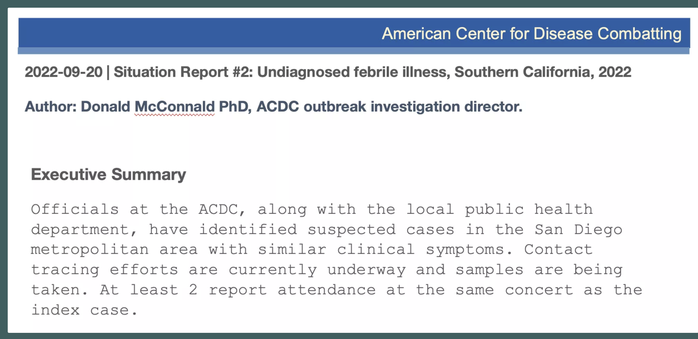

Slide 12
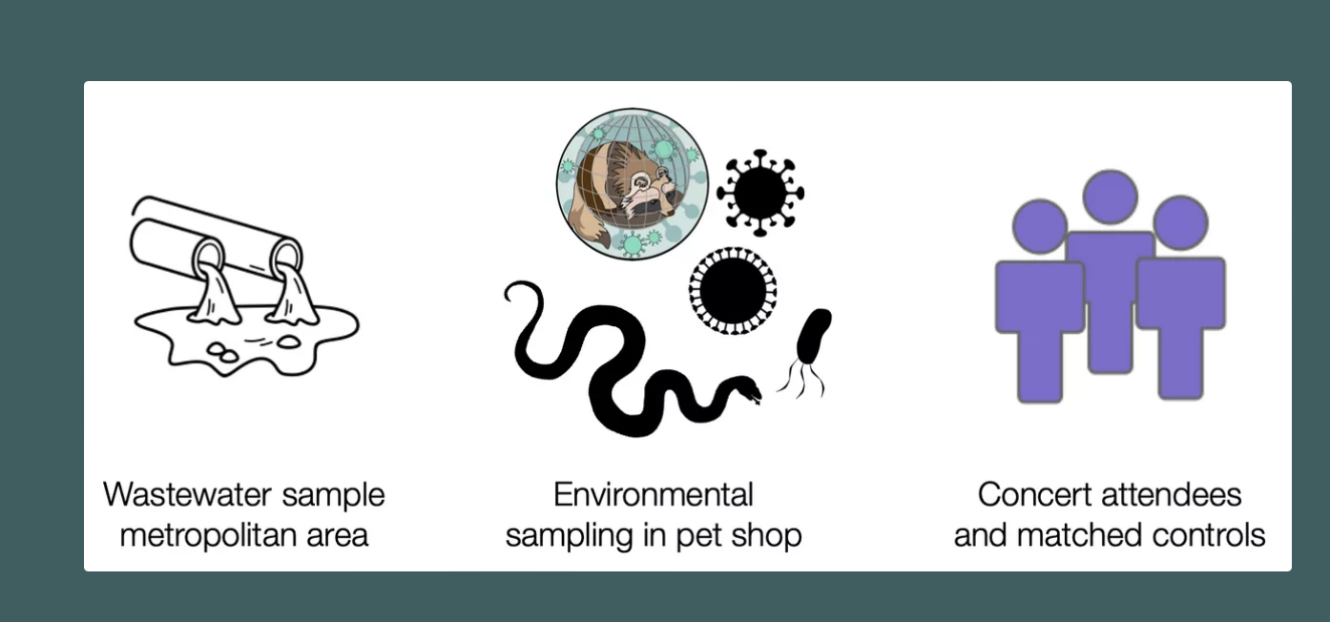
What do we sequence next?

Slide 13
Heavy Metal Associated Cases
https://artic-network.github.io/artic-live/gc/case_2_title.html
https://artic-network.github.io/artic-live/gc/case_3_title.html
https://artic-network.github.io/artic-live/gc/case_4_title.html

Slide 14
Heavy Metal Associated Controls
https://artic-network.github.io/artic-live/gc/control_1_title.html
https://artic-network.github.io/artic-live/gc/control_2_title.html
https://artic-network.github.io/artic-live/gc/control_3_title.html

Slide 15
Pet Shop Environmental Sampling
https://artic-network.github.io/artic-live/gc/pet_shop_env_title.html

Slide 16
Wastewaster Sampling
https://artic-network.github.io/artic-live/gc/wastewater_seq_title.html

Slide 17
What interventions are appropriate?

Slide 18
What pathogens are you ruling out and why?

Slide 19
What is the likely causative agent?

Slide 20
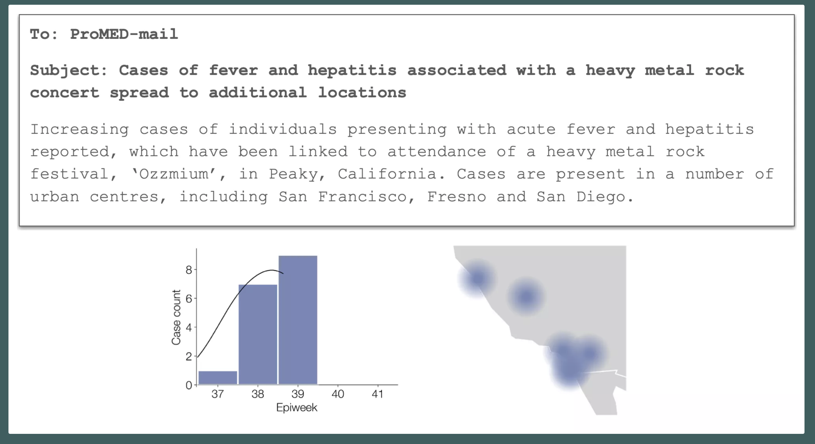

Slide 21
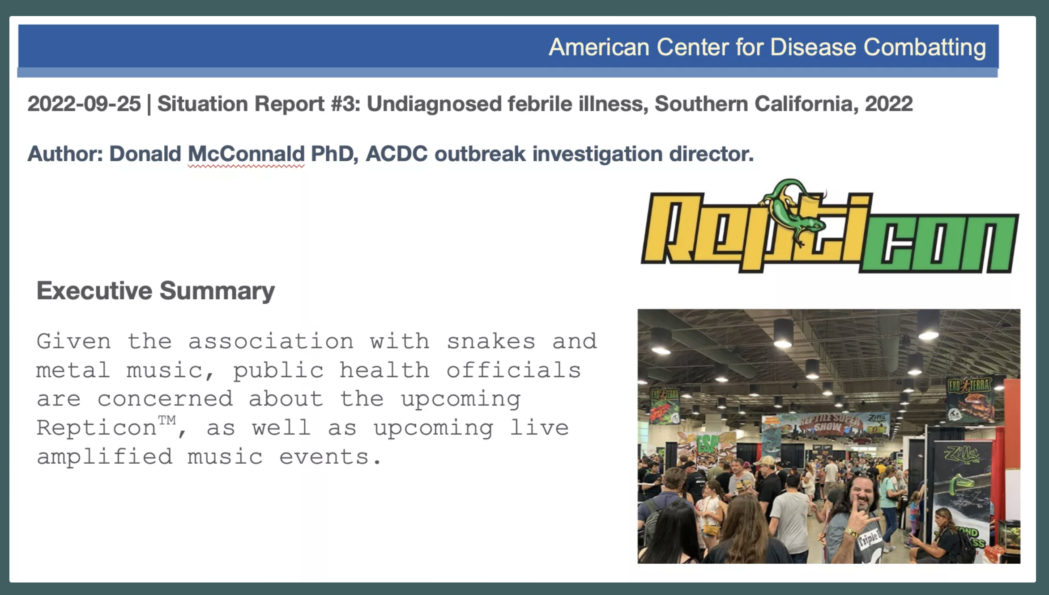

Slide 22
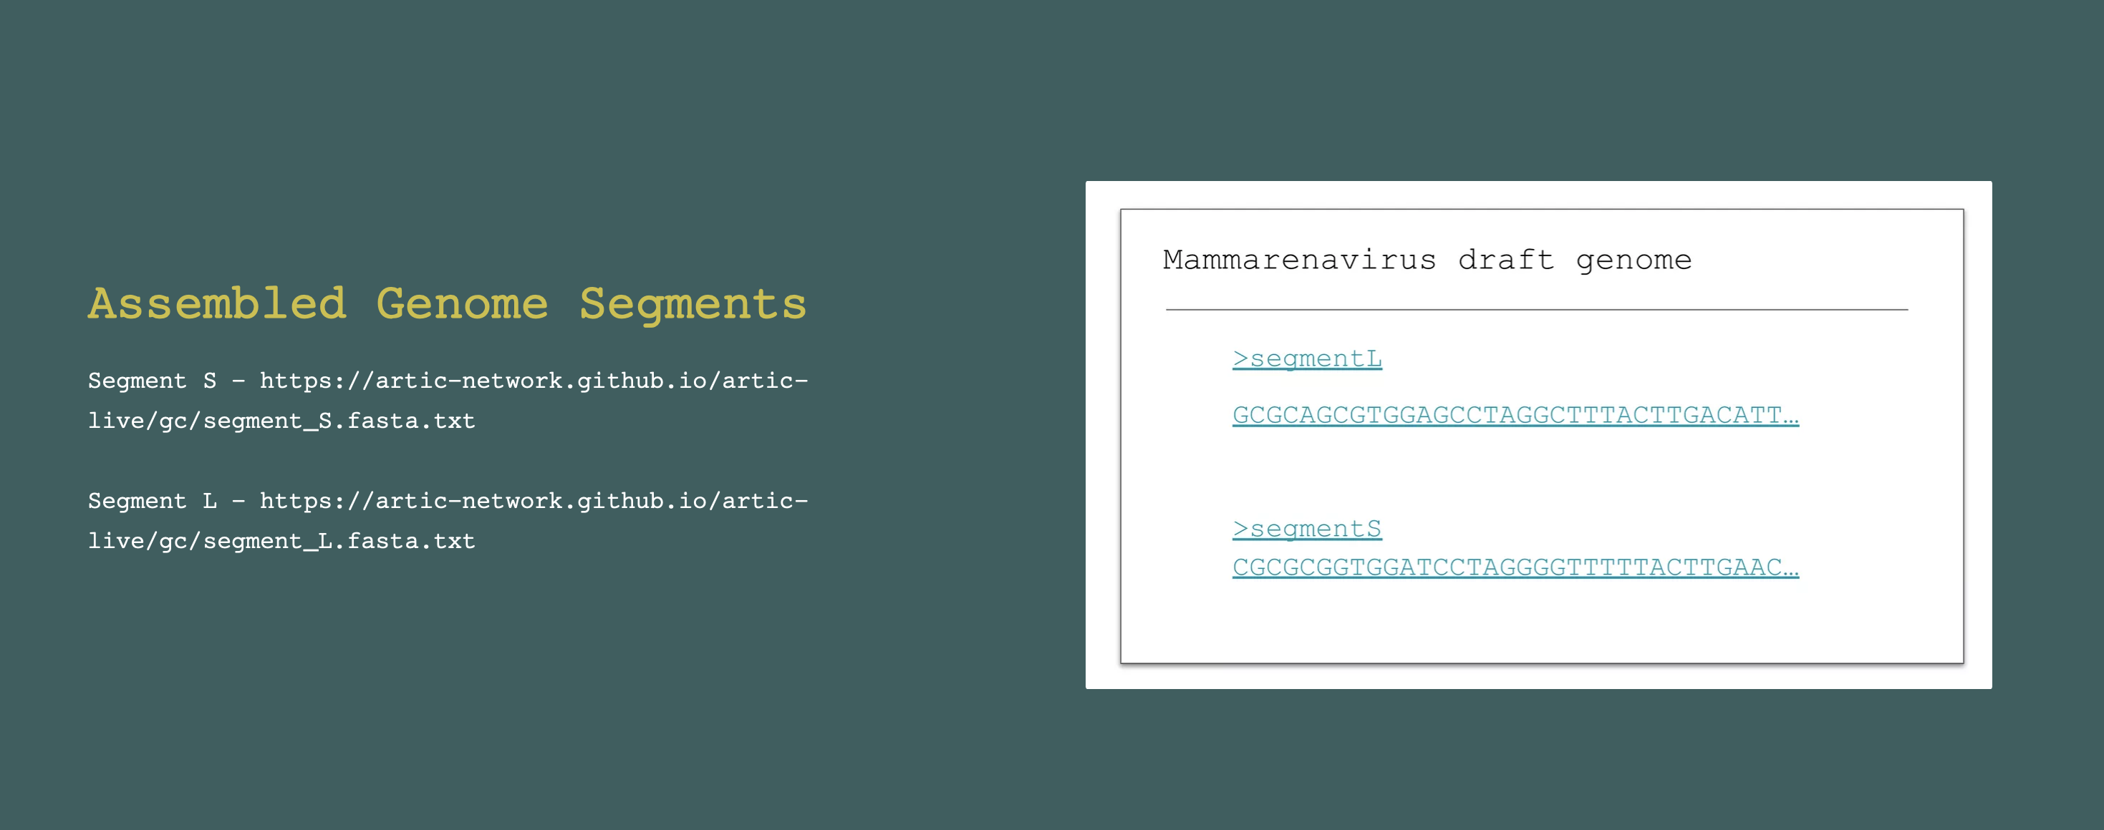
https://artic-network.github.io/artic-live/gc/segment_S.fasta.txt
https://artic-network.github.io/artic-live/gc/segment_L.fasta.txt

Slide 23


Slide 24
What is this virus?

Slide 25
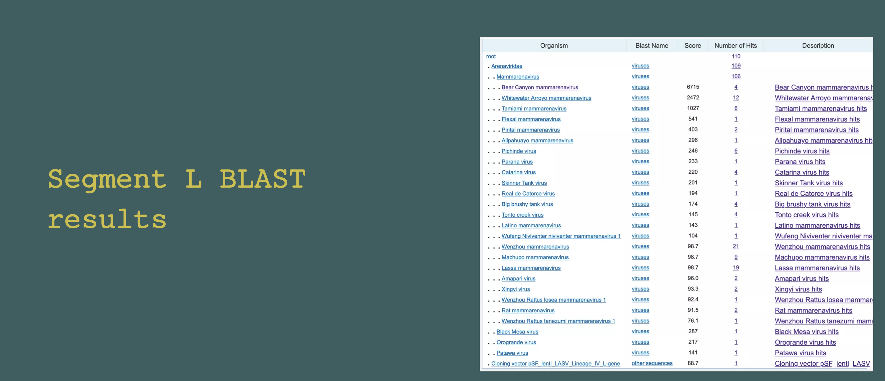

Slide 26
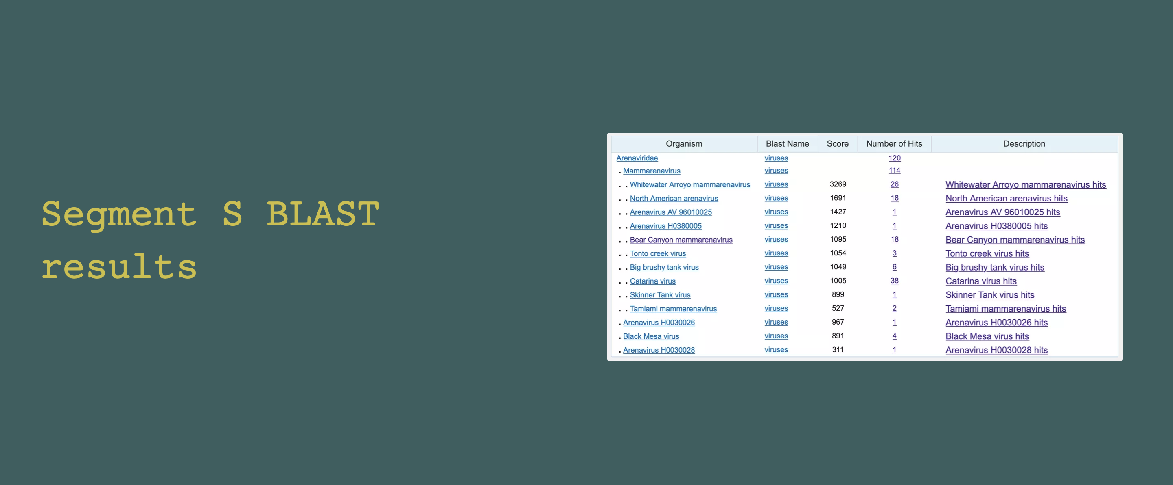

Slide 27
What should the virus be named?

Slide 28
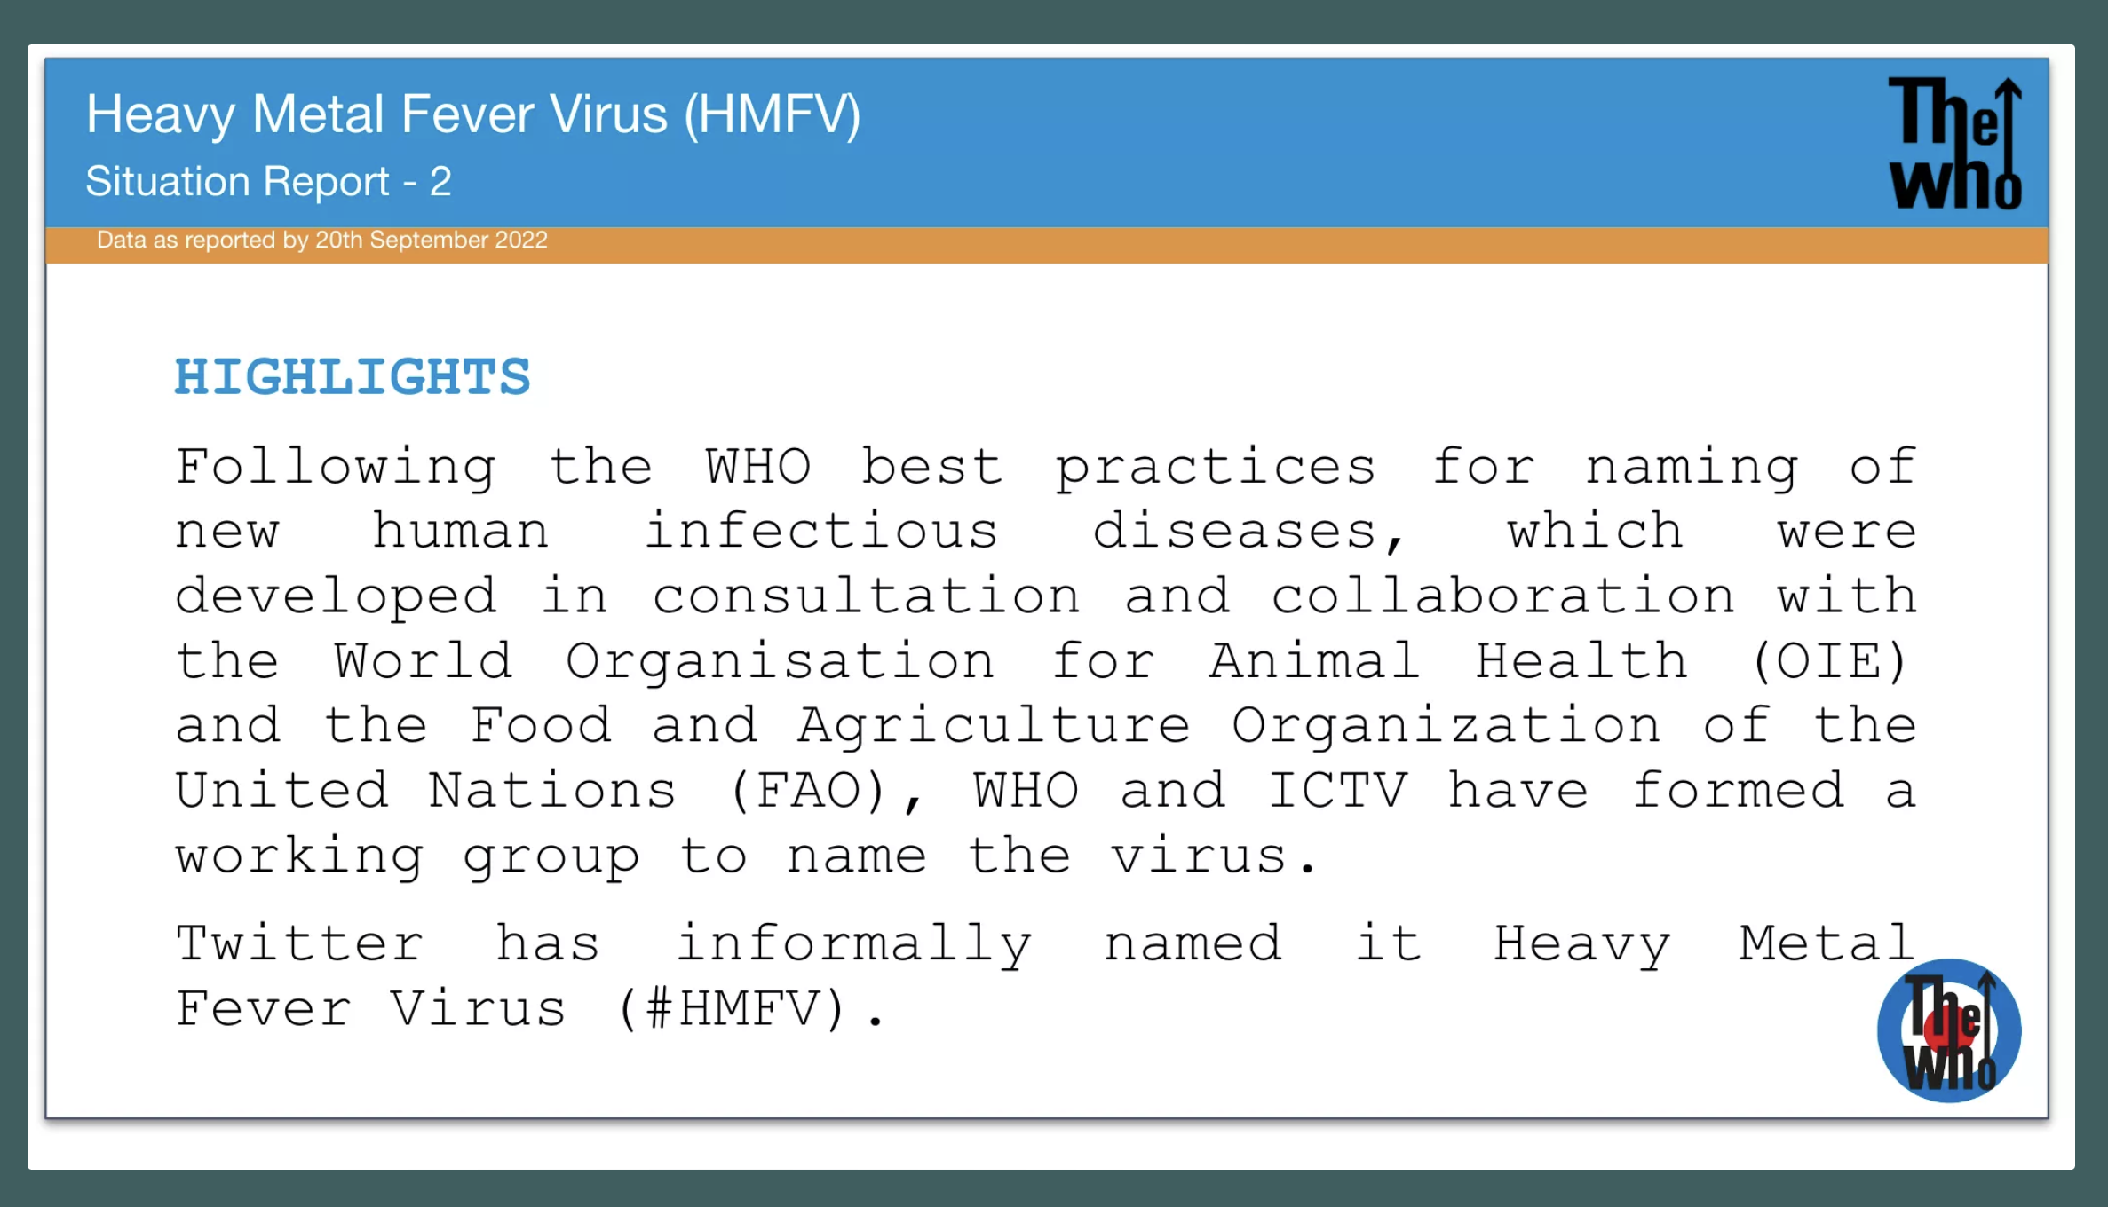

Slide 29
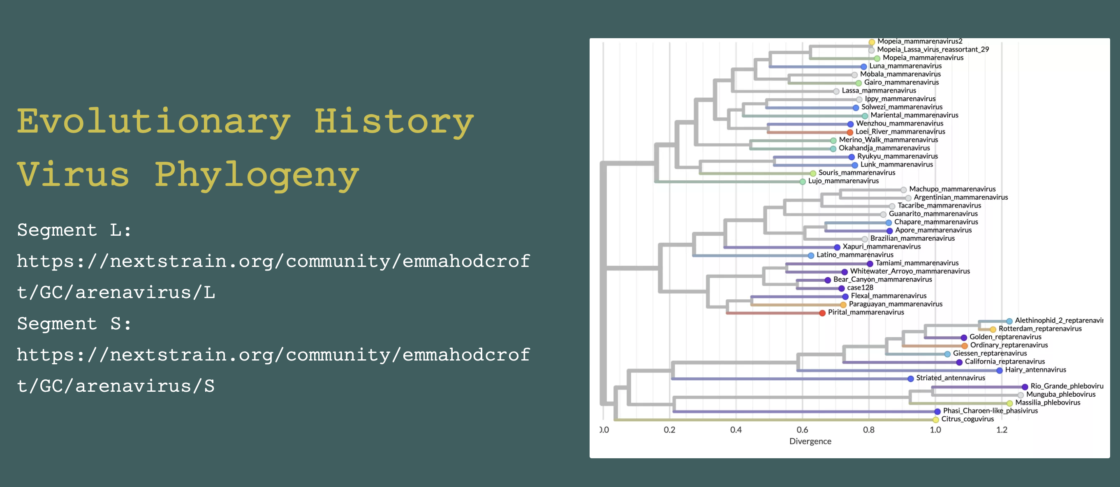
Segment L: https://nextstrain.org/community/emmahodcroft/GC/arenavirus/L
Segment S: https://nextstrain.org/community/emmahodcroft/GC/arenavirus/S

Slide 30
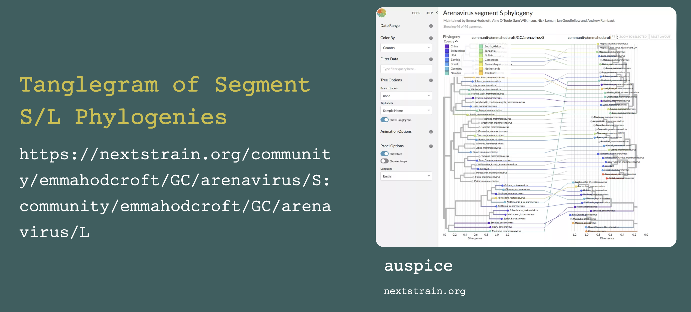
https://nextstrain.org/community/emmahodcroft/GC/arenavirus/S:community/emmahodcroft/GC/arenavirus/L

Slide 31
Advise policymakers on what this can tell us about the novel virus

Slide 32
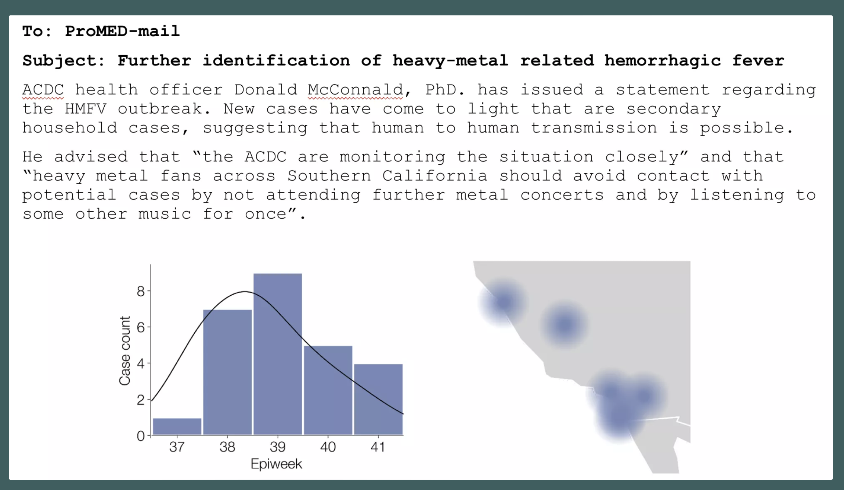

Slide 33
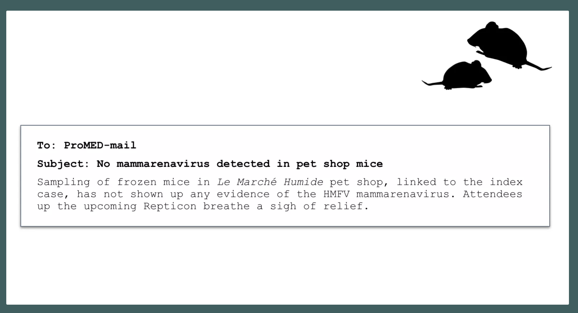

Slide 34
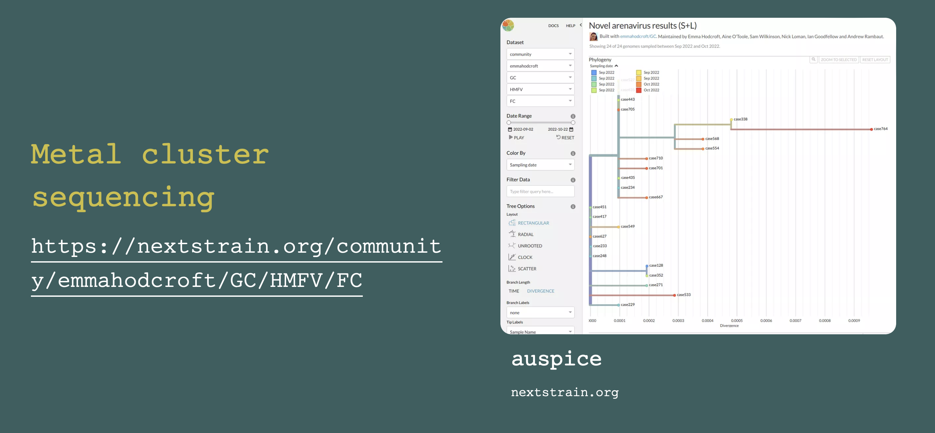
https://nextstrain.org/community/emmahodcroft/GC/HMFV/FC

Slide 35
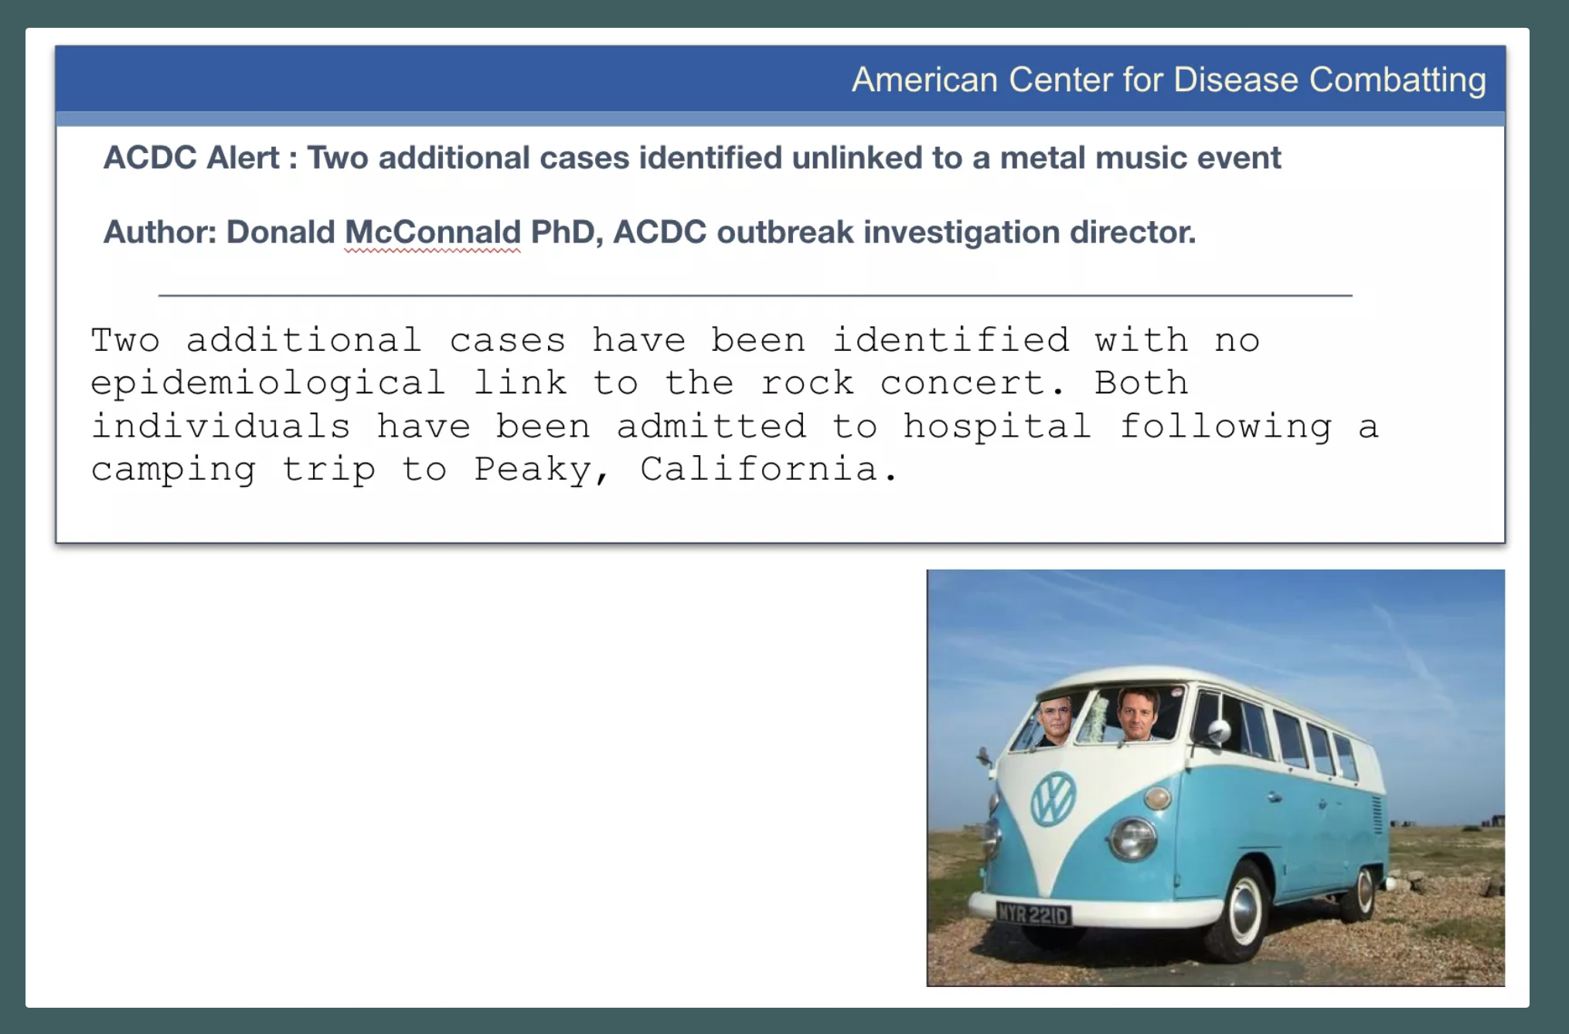

Slide 36
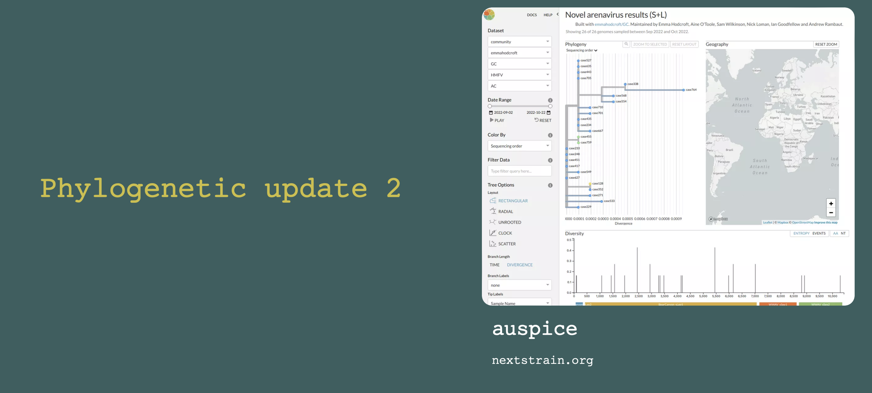

Slide 37
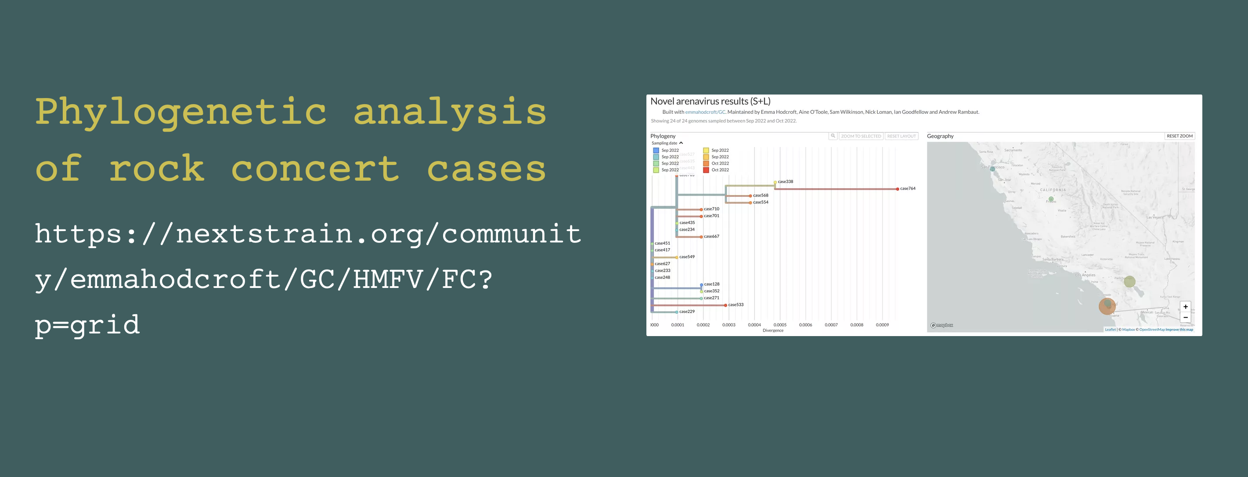
https://nextstrain.org/community/emmahodcroft/GC/HMFV/FC?p=grid

Slide 38
What can this tell us about the outbreak and when it may have started?

Slide 39
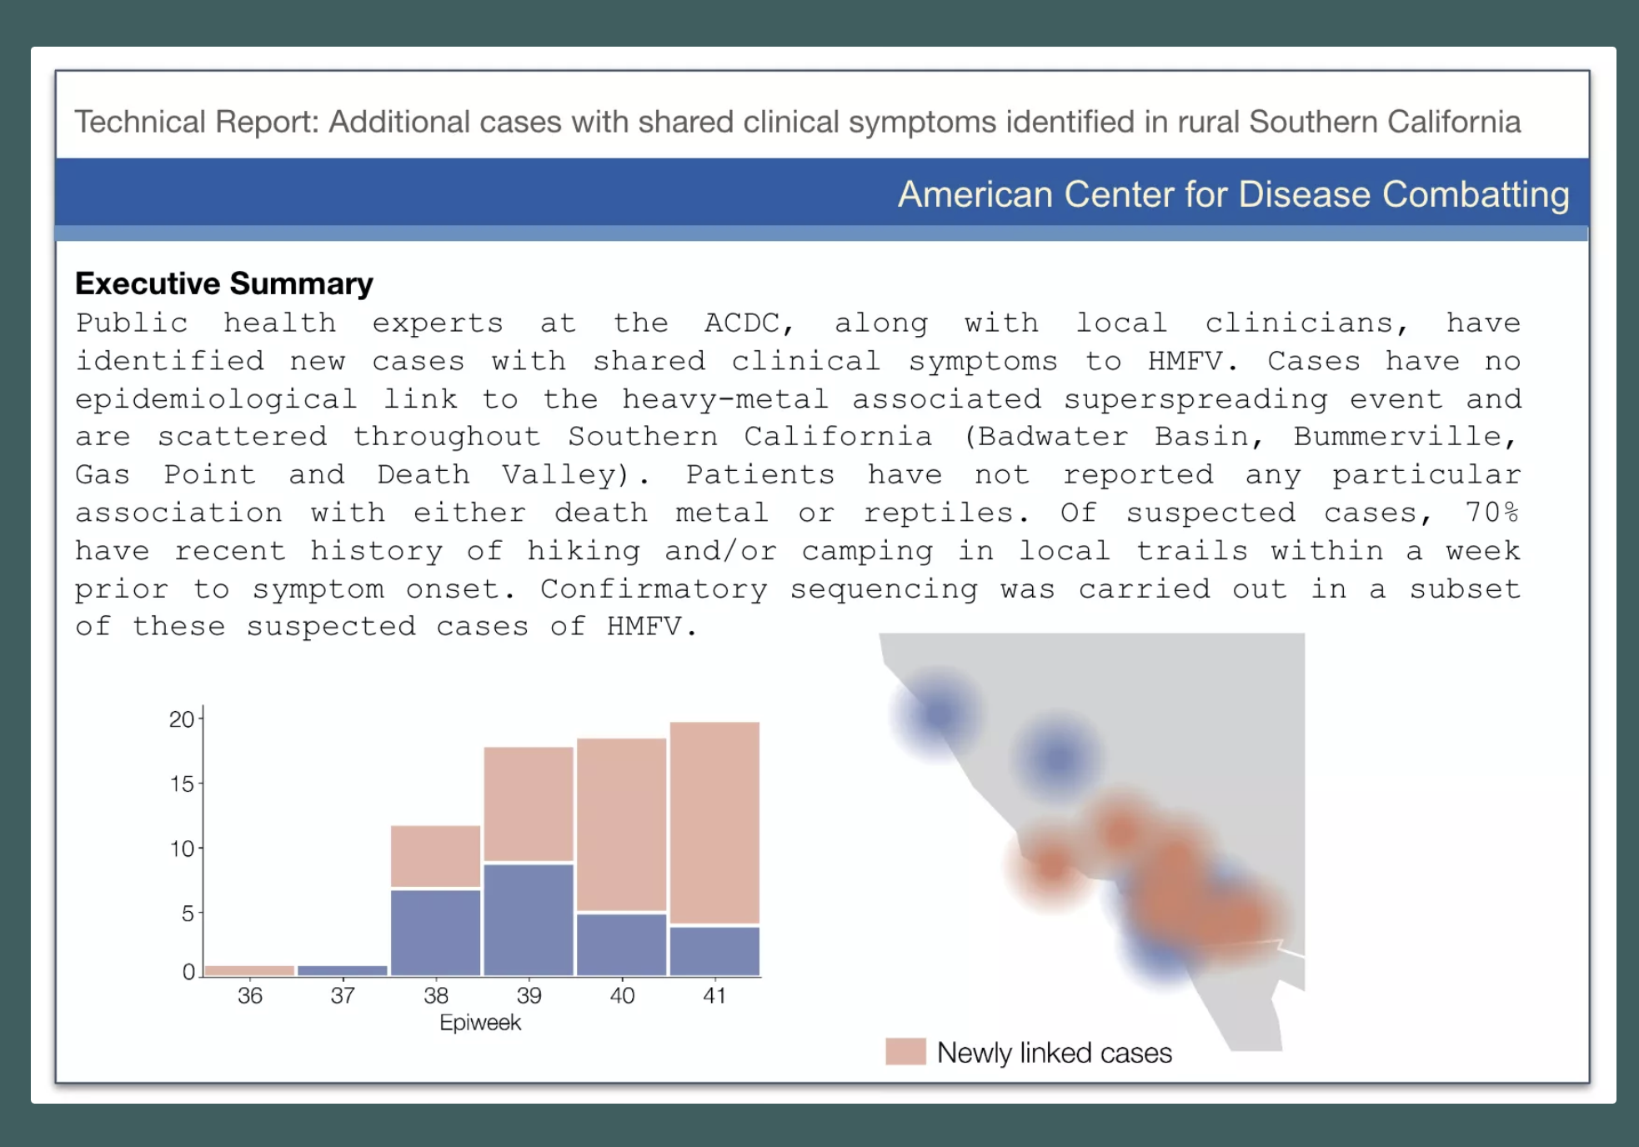

Slide 40
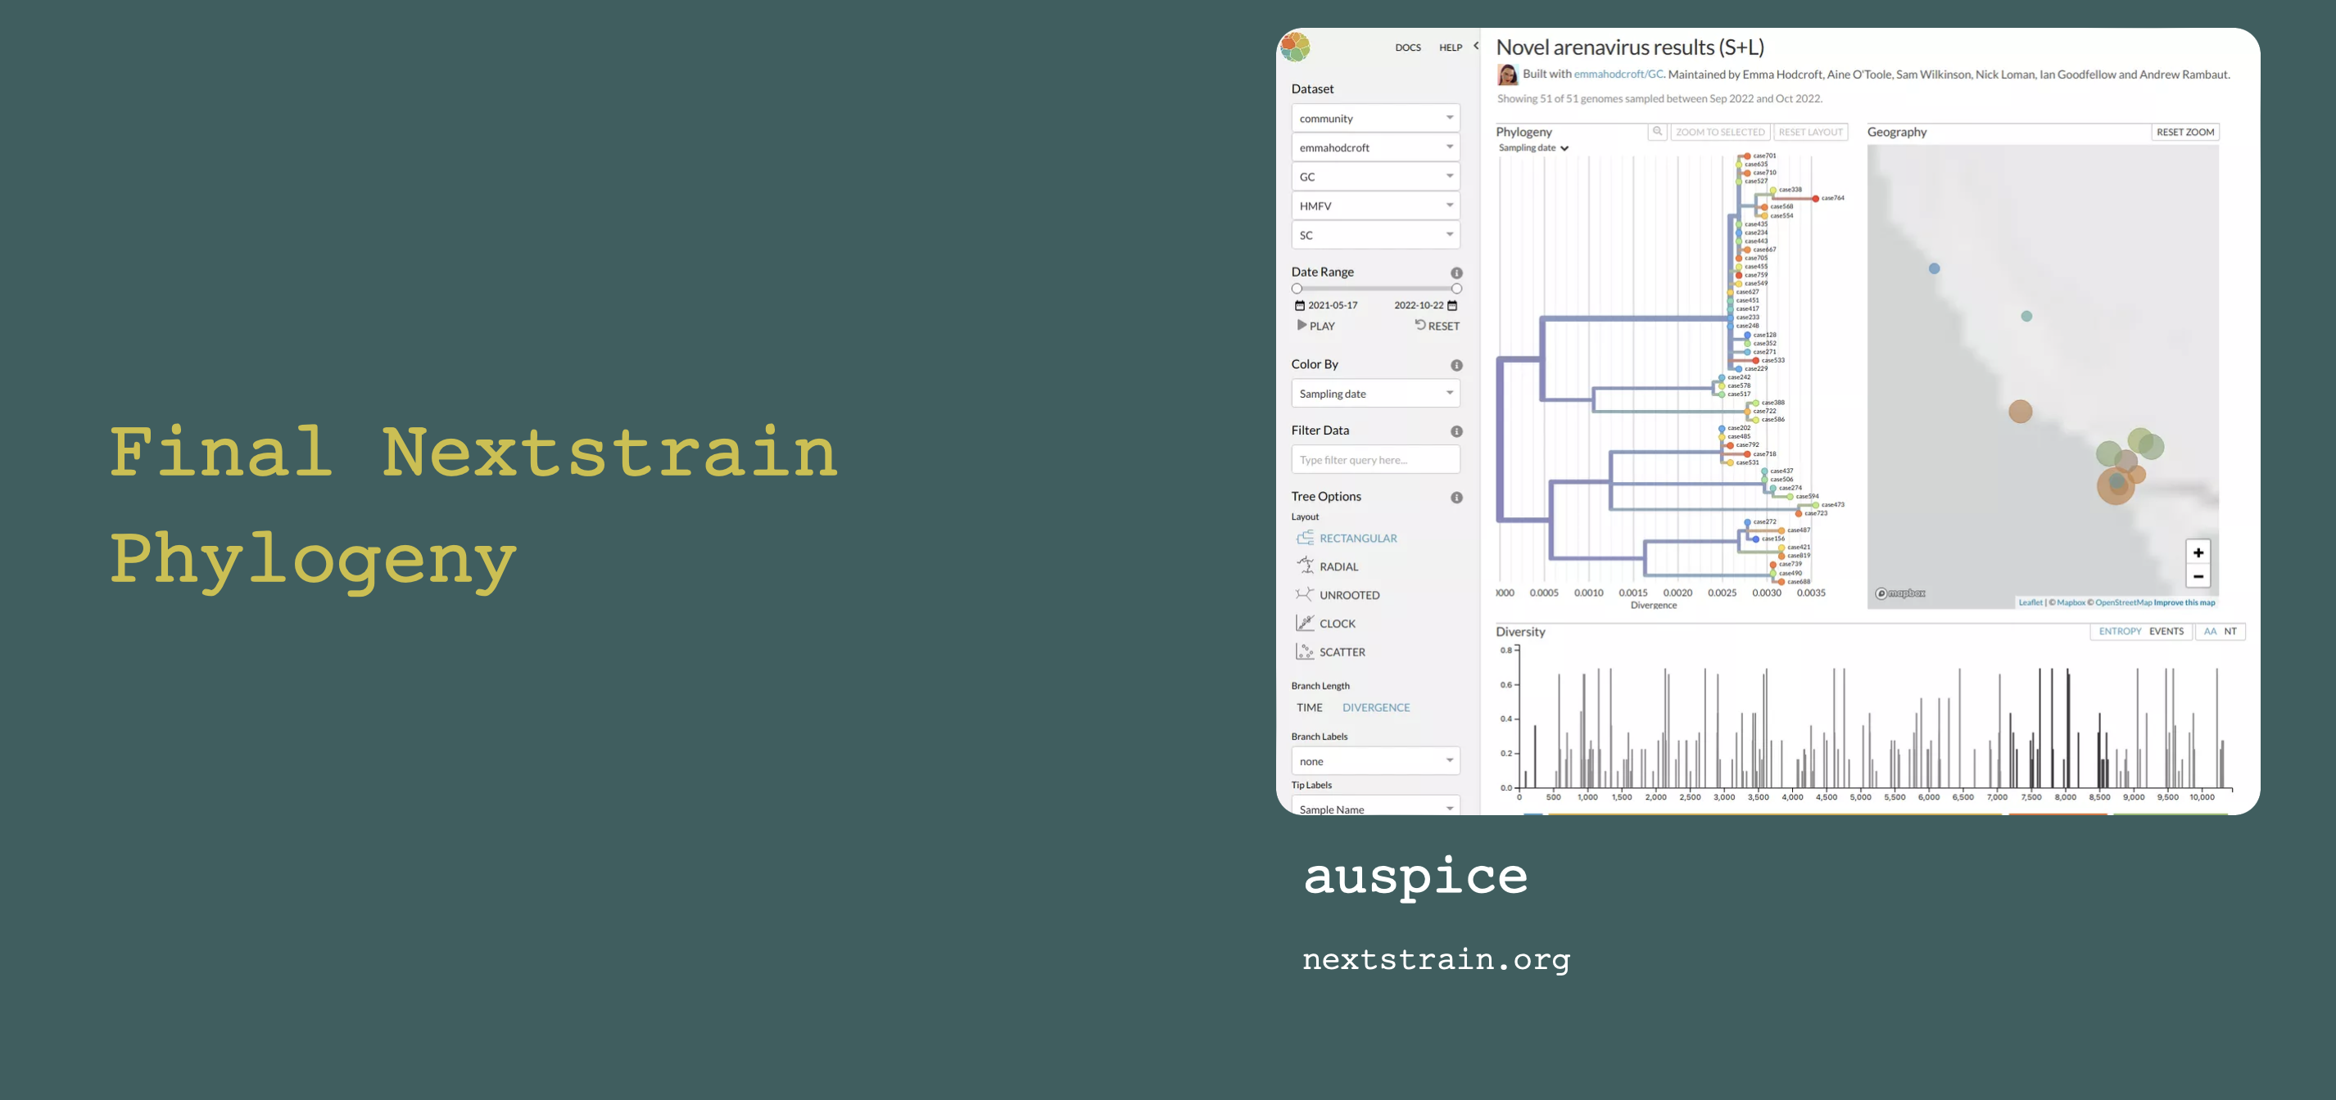
https://nextstrain.org/community/emmahodcroft/GC/HMFV/SC?p=grid

Slide 41
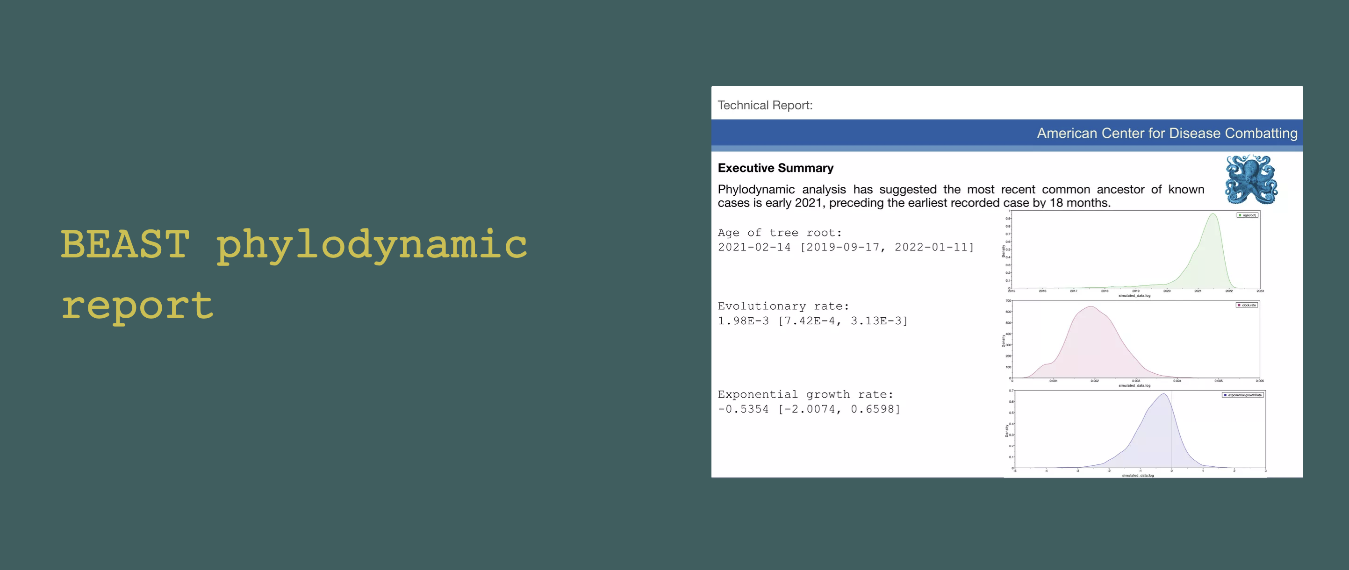

Slide 42
Does this change what we think about the outbreak?

Slide 43
How do we stop this outbreak from becoming a pandemic?

